Slide 1
DECLARE – TIMI 58
Embargoed Until Saturday Nov. 10, 3:45 pm CT, 4:45 pm ET
Stephen D. Wiviott, MD
for the DECLARE – TIMI 58 Investigators
American Heart Association, Scientific Sessions
November 10, 2018

Slide 2
Background
Patients with type 2 DM are at high risk for development of and complications from atherosclerotic CV events and heart failure.
Dapagliflozin is a selective SGLT-2 inhibitor which blocks glucose and sodium resorption in the kidney, and thereby ↓ blood sugar, BP & weight.
Zelniker TA, Braunwald E JACC 2018

Slide 3
Background
Patients with type 2 DM are at high risk for development of and complications from atherosclerotic CV events and heart failure.
Dapagliflozin is a selective SGLT-2 inhibitor which inhibits glucose resorption in the kidney, causes glucosuria, and thereby ↓ blood sugar, BP & weight.
Prior CV outcomes trials with SGLT-2i have shown reductions in CV and renal events predominantly in secondary prevention patients - with known ASCVD
Some safety questions with SGLT2i in other trials have been raised related to amputation, stroke and DKA.

Slide 4
Trial Design
17,160 with Type 2 DM
Established CV Disease (6974) or
Multiple Risk Factors (10186)
RANDOMIZE 1:1
DOUBLE BLIND
DAPAGLIFLOZIN
10 mg DAILY
PLACEBO
All other DM Rx per treating MD
Follow-up visits
In Person Q 6 mo/ telephone Q 3 mo
DURATION
EVENT DRIVEN
≥1390 MACE
Median follow up
4.2 years
Primary EPs
Safety: MACE (CVD/MI/Ischemic Stroke)
Dual Efficacy: CVD/HHF, MACE
Wiviott SD, Raz I…Sabatine MA, AHJ 2018

Slide 5
Enrollment Criteria
Diagnosis of T2DM, HbA1c 6.5-12%, CrCl ≥60 ml/min
AND
Established ASCVD (Secondary prevention)
Ischemic heart disease
Cerebrovascular disease
Peripheral Artery Disease
Or
Multiple risk factors for ASCVD (Primary prevention)
Men > 55 yrs and women > 60 yrs with at least one additional risk factor:
Dyslipidemia
Hypertension
Current Tobacco use
Wiviott SD, Raz I…Sabatine MA, AHJ 2018

Slide 6
Analytic Plan
MACE
Non-inferiority (Upper Bound CI <1.3): 1-sided α = 0.023
If non-inferior …
Superiority for Co-Primary Efficacy Endpoints (MACE & CVD/HHF)
divide α in half, test each simultaneously with 2-sidedα = 0.0231
if either significant, may recycle α to test other at 0.0462
If both significant …
Renal composite
40%↓ eGFR, ESRD, Renal or CV death
α = 0.0462
If significant …
All-cause mortality
α = 0.0462
Wiviott SD, Raz I…Sabatine MA, AHJ 2018

Slide 7
Trial Organization
TIMI Study Group
Marc Sabatine (Chair) Stephen Wiviott (PI) Marc Bonaca (NLI)
Christian Ruff (CEC Chair) P. Fish & A. Jevne (Operations) S. Murphy & J. Kuder (Statistics)
Sameer Bansilal (Fellow) Michael Silverman (Fellow) Eri Toda Kato (Fellow)
Thomas Zelniker (Fellow) Remo Furtado (Fellow)
Hadassah Medical Organization
Itamar Raz (PI) Ofri Mosenzon Avivit Cahn
Alona Buskila Aluma Weiss
Sponsor: AstraZeneca
Anna Maria Langkilde Ywonne Fox Ingrid Gause-Nilsson
Martin Fredriksson Peter Johansson Andrzej Towarowski
Sandra Ranft
Executive Committee
Marc Sabatine (Chair) Stephen Wiviott Itamar Raz
Deepak Bhatt Lawrence Leiter Darren McGuire
John Wilding Anna Maria Langkilde Ingrid Gause-Nilsson
Independent Data Monitoring Committee
Robert Harrington (Chair) Jaakko Tuomilehto Richard Nesto
Michael Droller Kerry Lee

Slide 8

Steering Committee
Argentina India South Africa
R. Diaz/ L. Litwak P. Kumar/ P. Pais F. Bonnici/ A. Dalby
Australia Israel Spain
P. Aylward/ M. Cooper B. Lewis/ J. Wainstein J. López-Sendón
Belgium Italy Sweden
L. Van Gaal D. Ardissino/ E. Bonora/ P. Merlini M. Dellborg/ C. Östgren
Brazil Japan Taiwan
F. Eliaschewitz/ J. Nicolau S. Goto/ T. Kadowaki/ E. Kato C. Chiang
Bulgaria Mexico Thailand
A. Goudev/ T. Tankova M. Herrera/ F. Padilla C. Deerochanawong
Canada Netherlands Turkey
L. Leiter/ P. Theroux A. Kooy/ T. Oude Ophuis I. Satman
China Philippines Ukraine
Y. Huo/ L. Ji M. Abola/ R. Sy A. Parkhomenko
Czech Republic Poland United Kingdom
A. Šmahelová/ J. Špinar A. Budaj/ K. Strojek K. Ray/ J. Wilding
France Republic of Korea United States
S. Hadjadj/ G. Montalescot K. Park M. Bonaca/ J. Dwyer/ J. Rosenstock
Germany Romania Vietnam
C. Bode/ M. Nauck S. Cernea/ D. Dimulescu T. Nguyen
Hong Kong Russian Federation
R. Ma O. Averkov/ M. Ruda/ M. Shestakova
Hungary Slovakia
G. Jermendy/ R. Kiss I. Tkáč

Slide 9
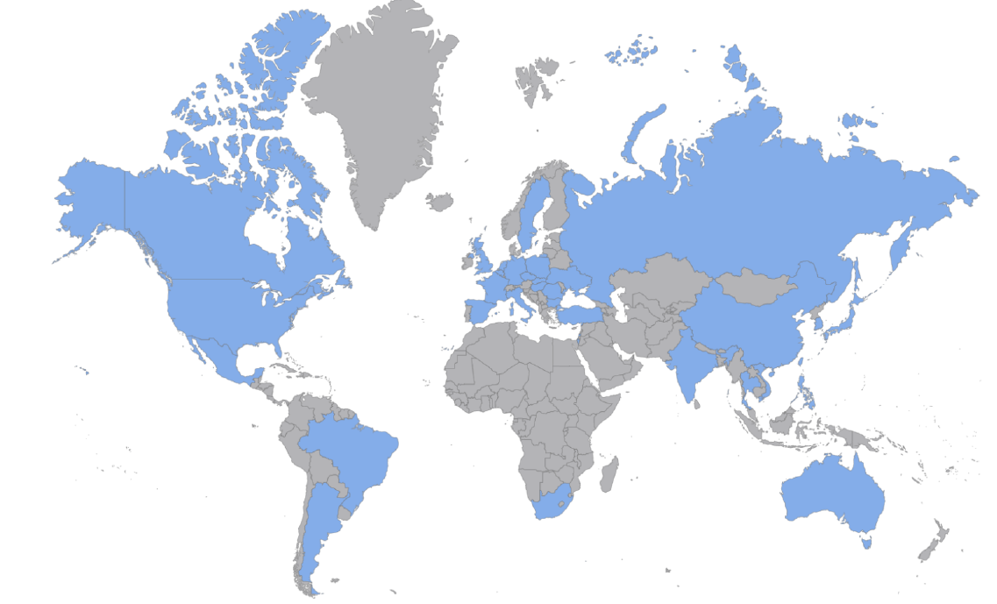
Global Enrollment
17,160 patients randomized at 882 sites, 33 countries between
5/2013-6/2015
Sweden
453
Czech Republic
638
UK: 366
Poland: 931
Canada
1585
Germany: 215
Russian Federation
395
Netherlands: 401
Ukraine: 356
Republic of Korea
357
Belgium:114
Romania
483
USA
3884
France: 187
Turkey: 53
China
215
Japan
95
Mexico
868
Spain: 195
Bulgaria
832
Taiwan
110
Italy:155
Slovakia: 346
India:193
Philippines
335
Brazil
326
Hungary
713
Thailand
259
Israel
340
Hong Kong
50
Vietnam
157
Argentina
683
South Africa
456
Australia
414

Slide 10
Follow-up
Randomized17,160 patients
Established ASCVD (6,974), MRF (10,186)
Dapagliflozin
(N=8582)
Placebo
(N=8578)
Follow-up median 4.2 (IQR 3.9-4.4)
1559 patients experienced MACE
913 experienced CVD/HHF
Premature perm. drug discontinuation | 5.2%/yr | 6.2%/yr
Withdrew consent | 0.28%/yr | 0.37%/yr
Lost to follow-up | 12 patients | 18 patients

Slide 11
Baseline Characteristics
 | Full Trial Cohort N = 17160
Age , Mean (SD) | 64 (7)
Female Sex (%) | 37
BMI, Mean (SD) | 32 (6)
Duration of T2DM, Median (IQR) | 11 (6, 16)
HbA1c, Mean (SD) | 8.3 (1.2)
eGFR (CKD-EPI), Mean (SD) | 85 (16)
Region (%): North America | 32
Europe | 44
Latin America | 11
Asia Pacific | 13
Established CV Disease (%) | 41
History of Heart Failure (%) | 10
P=NS for all between treatment arm comparisons

Slide 12
Baseline Characteristics:
Medication Use
 | Full Trial Cohort N = 17160
Glucose lowering therapies (%)
Metformin | 82
Insulin | 41
Sulfonylurea | 43
DPP4 | 17
GLP-1 RA | 4
Cardiovascular Therapies (%)
Antiplatelet | 61
ACEI/ARB | 81
Beta-blocker | 53
Statin or Ezetimibe | 75
P=NS for all between treatment arm comparisons

Slide 13
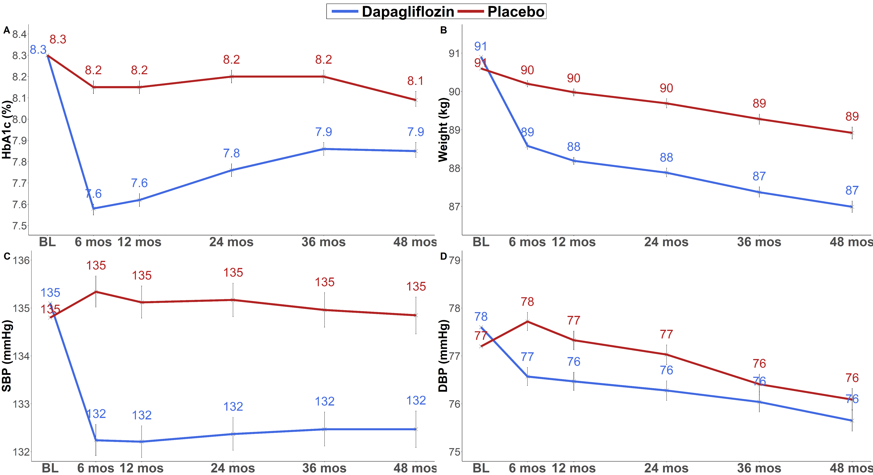
Cardiovascular Risk Factors
HbA1c
Weight
LSM Difference 0.42% (95% CI 0.40-0.45)
LSM Difference 1.8 kg (95% CI 1.7-2.0)
All P-values (except BL) <0.001
All P-values (except BL) <0.001

Slide 14

Cardiovascular Risk Factors
SBP
DBP
LSM Difference 2.7 mmHg (95% CI 2.4-3.0)
LSM Difference 0.7mmHg (95% CI 0.6-0.9)
All P-values (except BL) <0.001
All P-values (except BL) <0.001

Slide 15
Primary Endpoints
CVD/HHF
MACE
4.9% vs 5.8%
HR 0.83 (0.73-0.95)
P(Superiority) 0.005
8.8% vs 9.4%
HR 0.93 (0.84-1.03)
P(Noninferiority) <0.001
P(Superiority) 0.17

Slide 16
Secondary Endpoints
1st Renal Composite EP
40%↓ eGFR, ESRD, Renal or CV death
All-Cause Mortality
4.3% vs. 5.6%
HR 0.76 (0.67-0.87)
P<0.001
6.2% vs 6.6%
HR 0.93 (0.82-1.04)
P=0.20

Slide 17
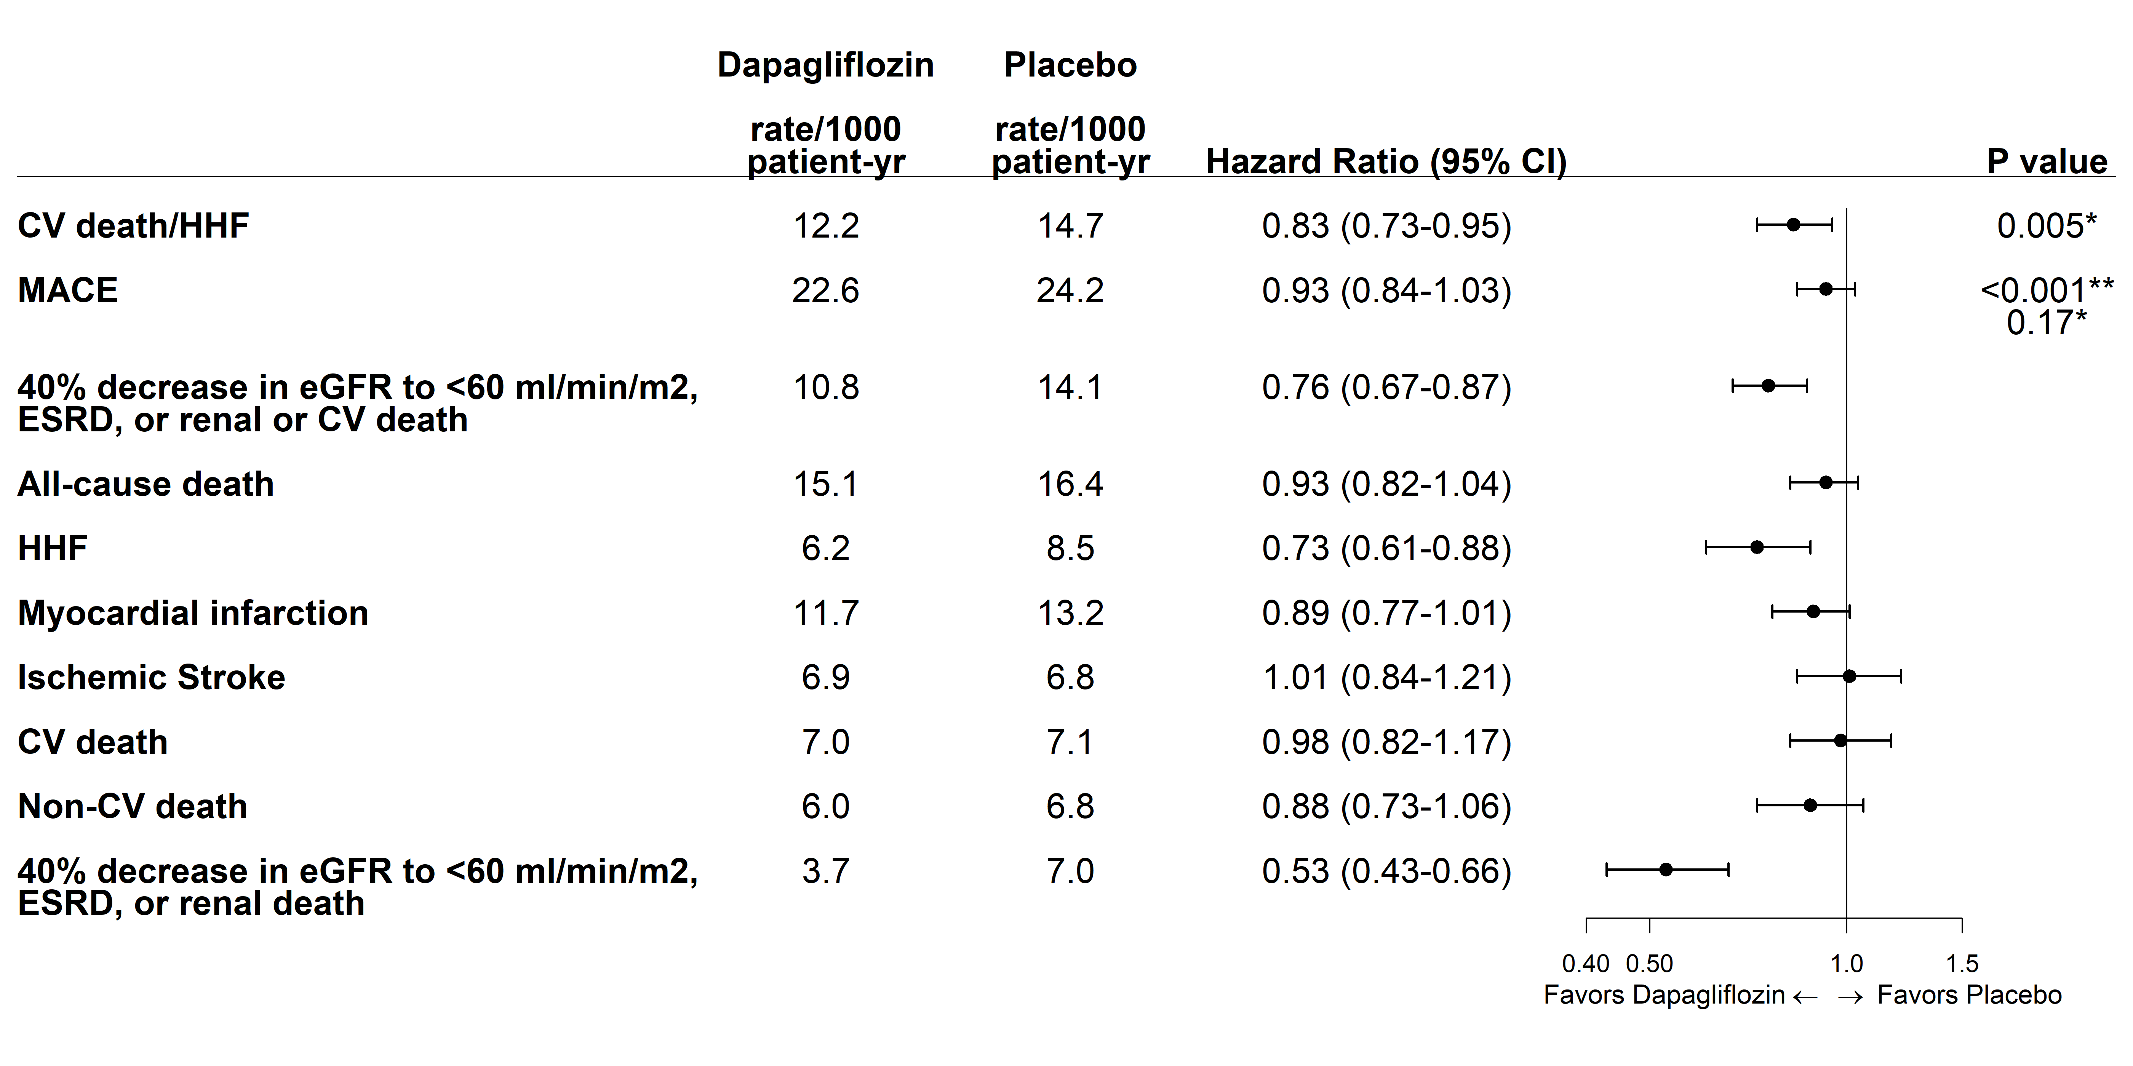
Endpoints and Components
Dapagliflozin
Placebo
*P for superiority, **P for non-inferiority

Slide 18
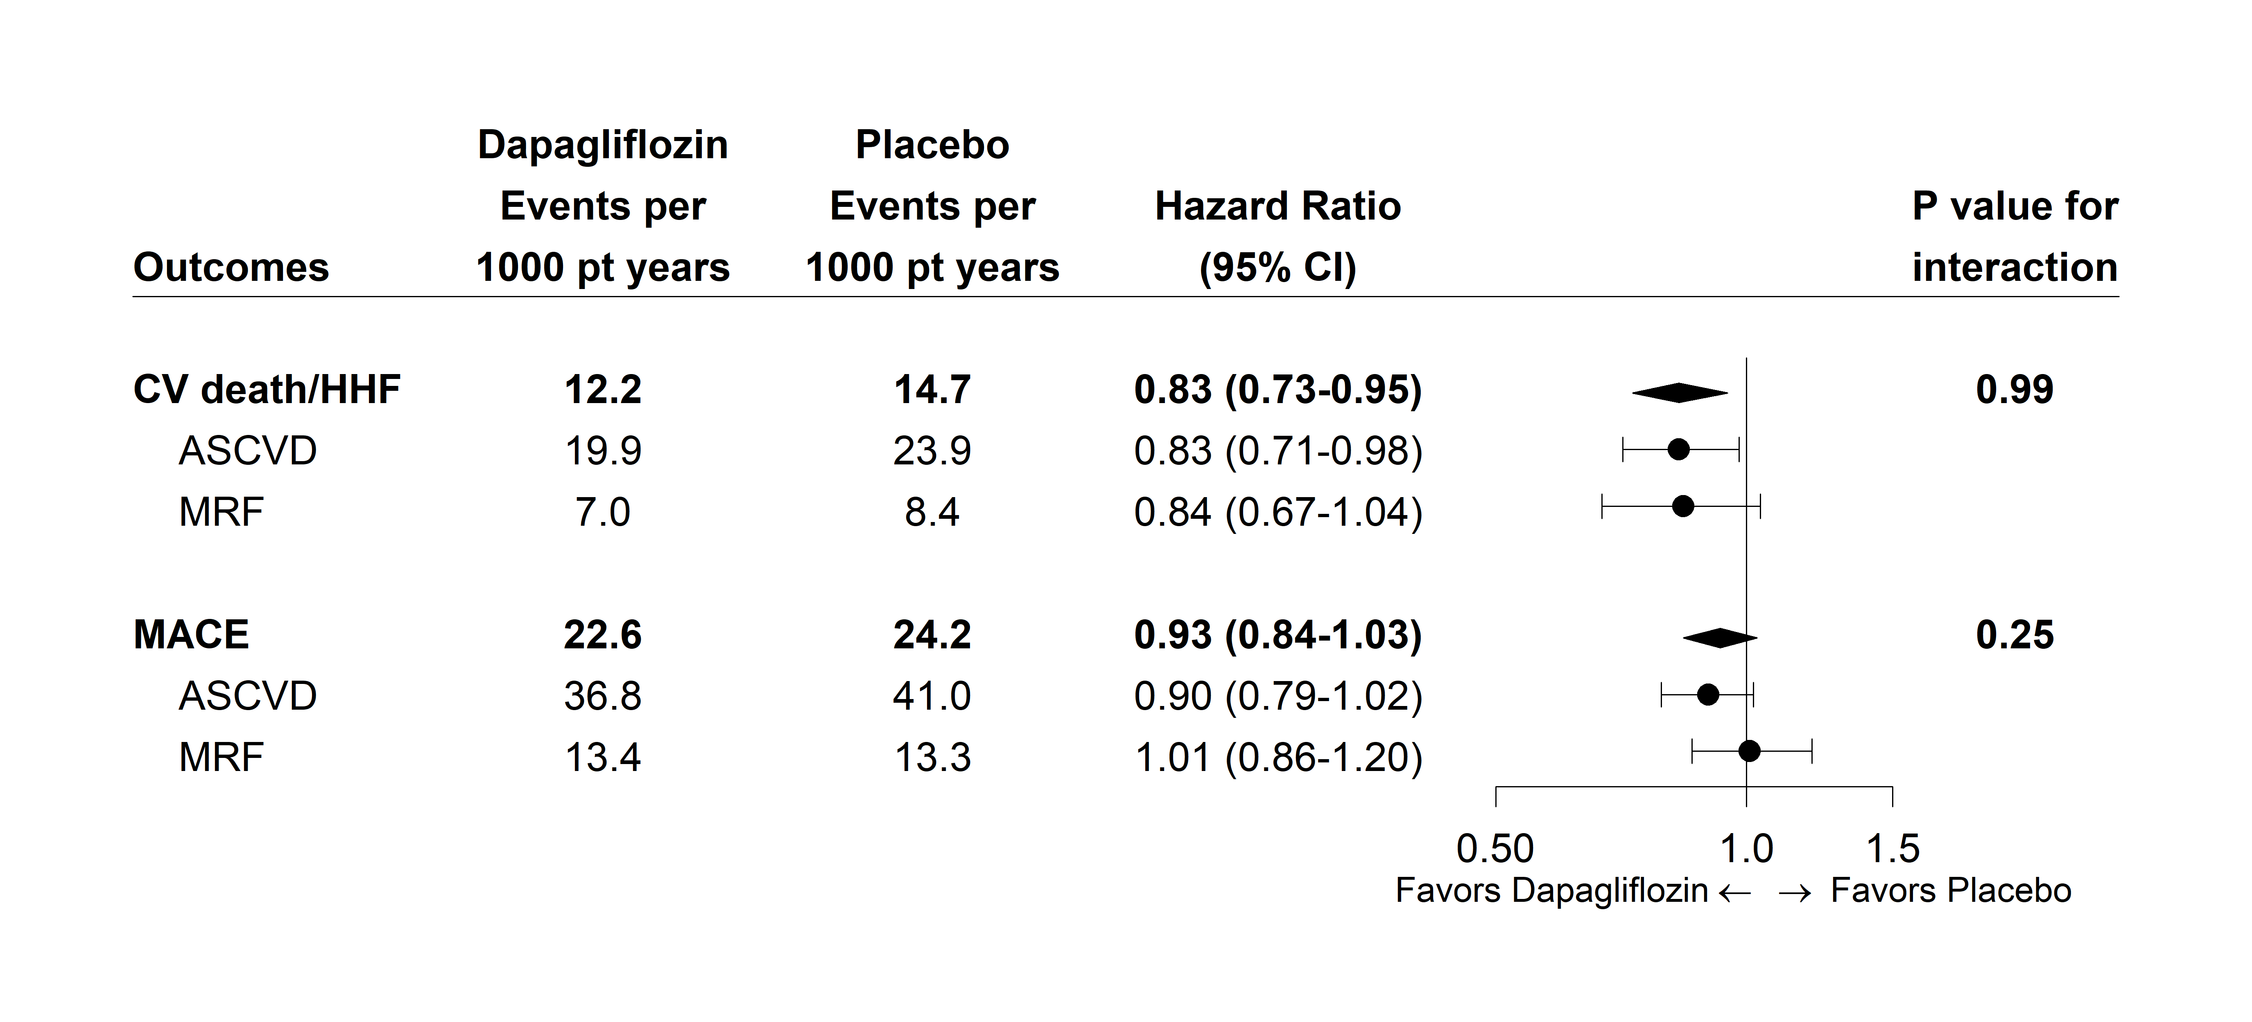
Primary Efficacy Endpoints by presence of ASCVD vs MRF
Dapagliflozin
Placebo

Slide 19
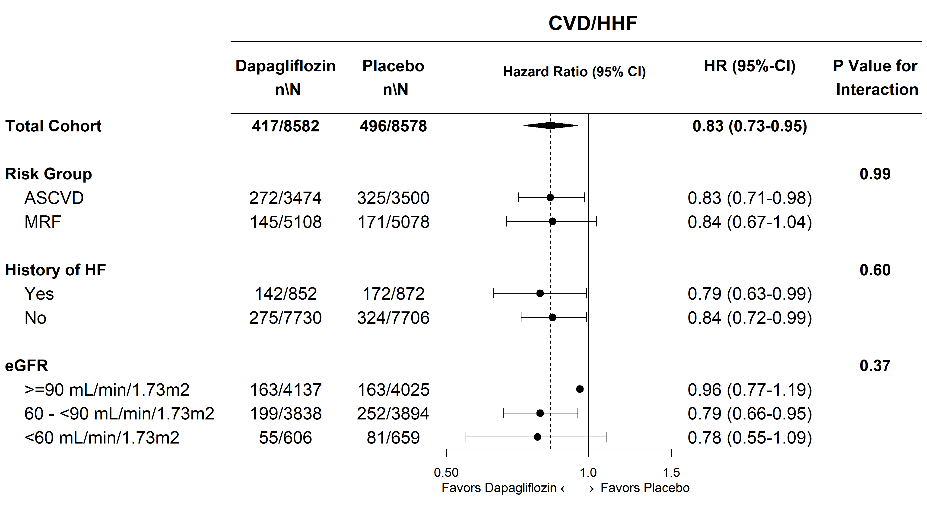
Effect on CVD/HHF in Key Subgroups
CVD/HHF
MACE

Slide 20
Key Safety Events
 | Dapagliflozin (%) | Placebo (%) | Between Group Comparison
Treatment emergent SAE | 34.1 | 36.2 | P<0.001
Treatment emergent AE leading to drug D/C | 8.1 | 6.9 | P=0.01
Major Hypoglycemia | 0.7 | 1.0 | P=0.02
Diabetic Ketoacidosis* (DKA) | 0.3 | 0.1 | P=0.02
Amputation | 1.4 | 1.3 | NS
Fracture | 5.3 | 5.1 | NS
Symptoms of volume depletion | 2.5 | 2.4 | NS
Genital infection (SAE, DAE) | 0.9 | 0.1 | P<0.001
Urinary tract infection (SAE, DAE) | 1.5 | 1.6 | NS
Fournier’s Gangrene | 0.0 | 0.1 | NS
Malignancy event* | 5.6 | 5.7 | NS
Cancer of Bladder* | 0.3 | 0.5 | P=0.02
Hepatic event* | 1.0 | 1.0 | NS
*CEC Adjudicated

Slide 21
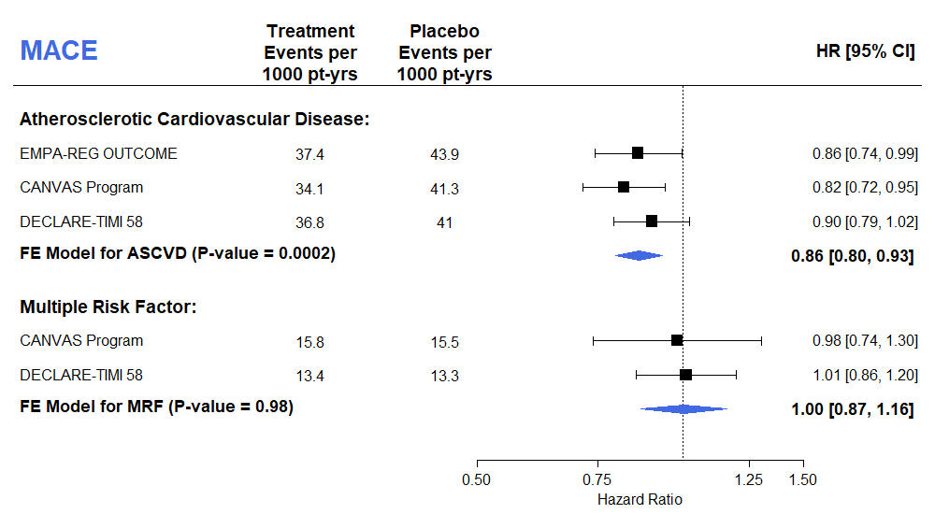
Meta-Analysis of CVOTs:
MACE by Presence of ASCVD
Test for Subgroup Differences p=0.05
Zelniker TA, Wiviott SD…Sabatine MA, Lancet 2018

Slide 22
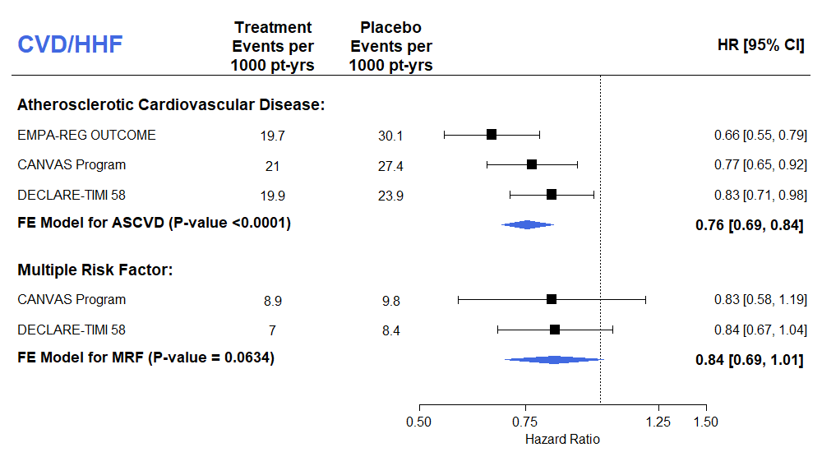
Meta-Analysis of CVOTs:
CVD/HHF by Presence of ASCVD
Test for Subgroup Differences p=0.41
Zelniker TA, Wiviott SD…Sabatine MA, Lancet 2018

Slide 23
Summary
In DECLARE – TIMI 58, the largest SGLT-2i trial, which included a broad representation of 1° and 2° prevention patients:
Dapagliflozin reduced CVD/HHF and neither increased nor decreased MACE
  Reduction in CVD/HHF was consistent regardless of baseline ASCVD or HF
Dapagliflozin was safe and generally well-tolerated
   Genital infections & DKA
  no difference in: amputation, stroke, or fracture
   hypoglycemia, bladder Ca

Slide 24
Conclusions
Now with the context of 3 large CVOTs:
SGLT-2 inhibitors have moderate benefits on atherosclerotic MACE that appear confined to those with established ASCVD
SGLT-2 inhibitors have robust effects on reducing the risk of heart failure and renal outcomes which do not appear dependent on baseline atherosclerotic risk, prior HF, or renal function.
These data with dapagliflozin from DECLARE - TIMI 58 extend the benefit of SGLT2i to a broader population of patients for primary and secondary prevention

Slide 25
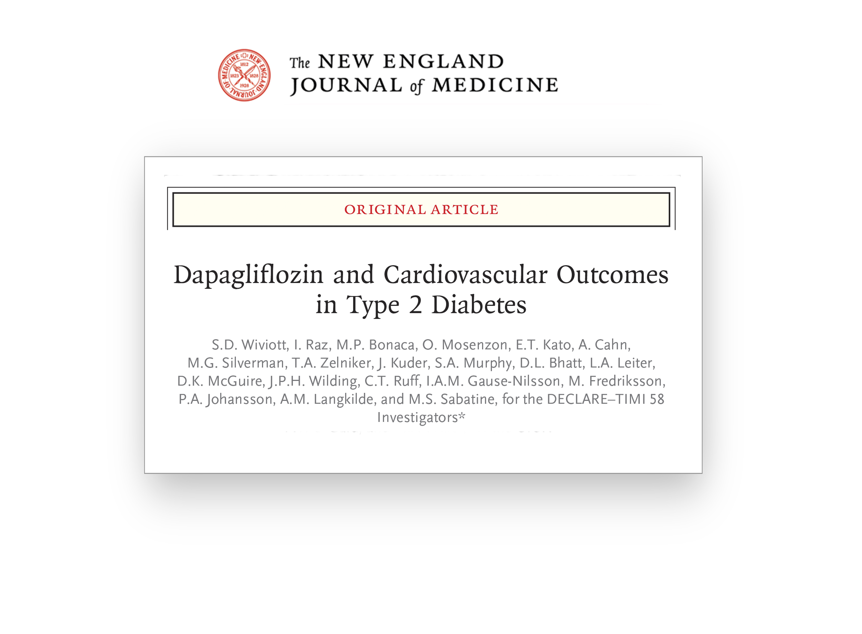

Additional Information
LBCT slides available:
www.timi.org

